Slide 1
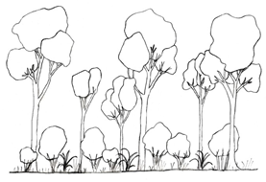
Detailed ecology survey data can be captured using a general purpose ontology
Simon J D Cox
CSIRO Land and Water, Melbourne, Australia
Siddeswara Guru
TERN, University of Queensland, Brisbane, Australia

Slide 2
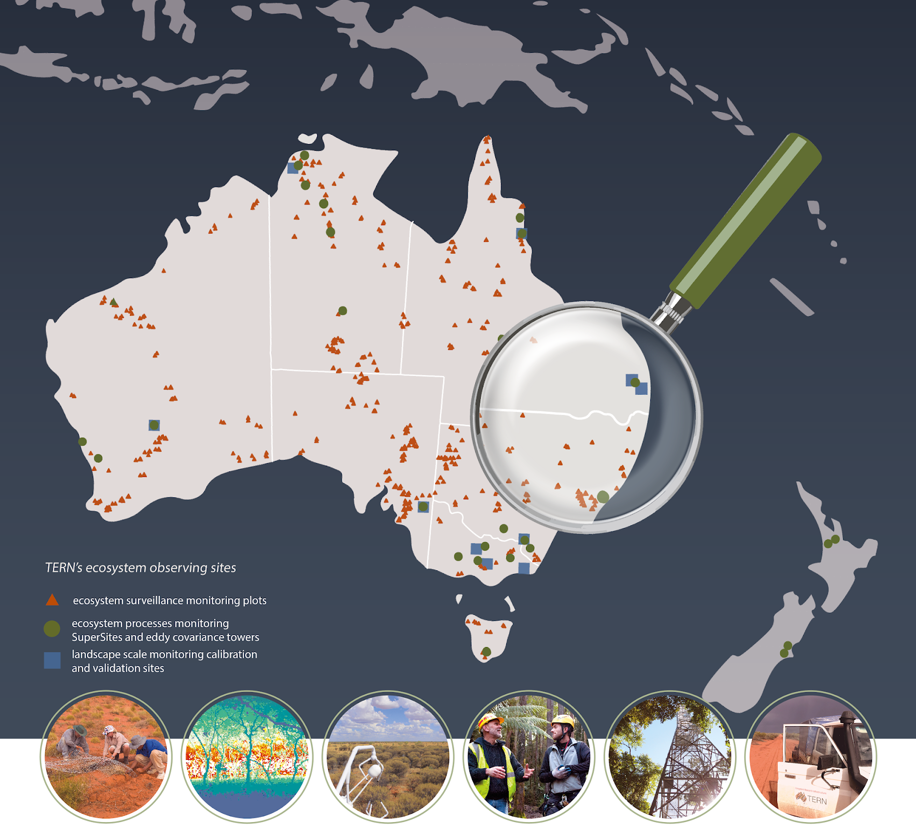

Australia’s land ecosystem observatory

Slide 3
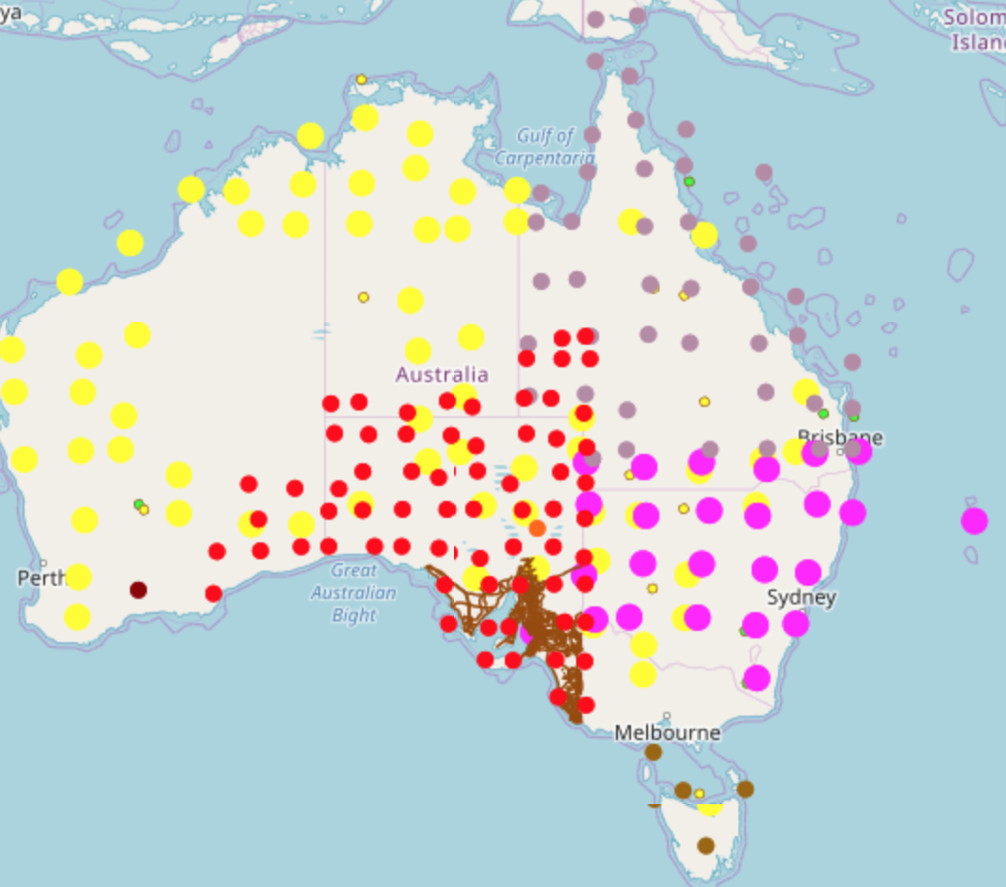

Aggregator of plot-based ecology data across state agencies
Aggregate plot-based ecology data
Over 96000 plots from all the states of Australia
Cover over 250 ecology attributes
Contributing towards vegetation data exchange standard

Slide 4
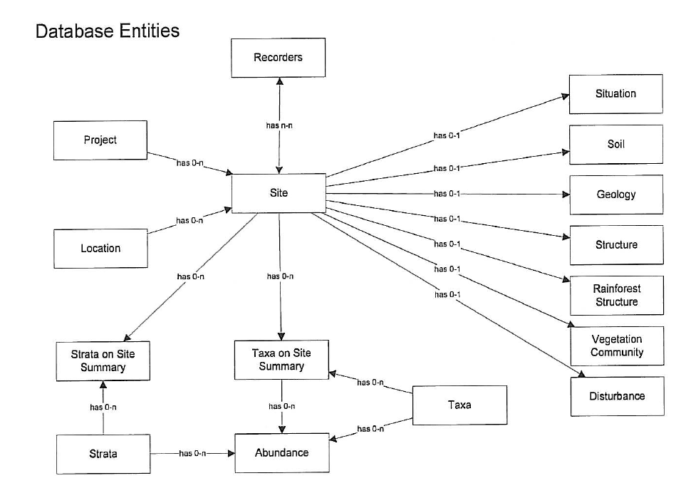
Qld (CORVEG)

Slide 5
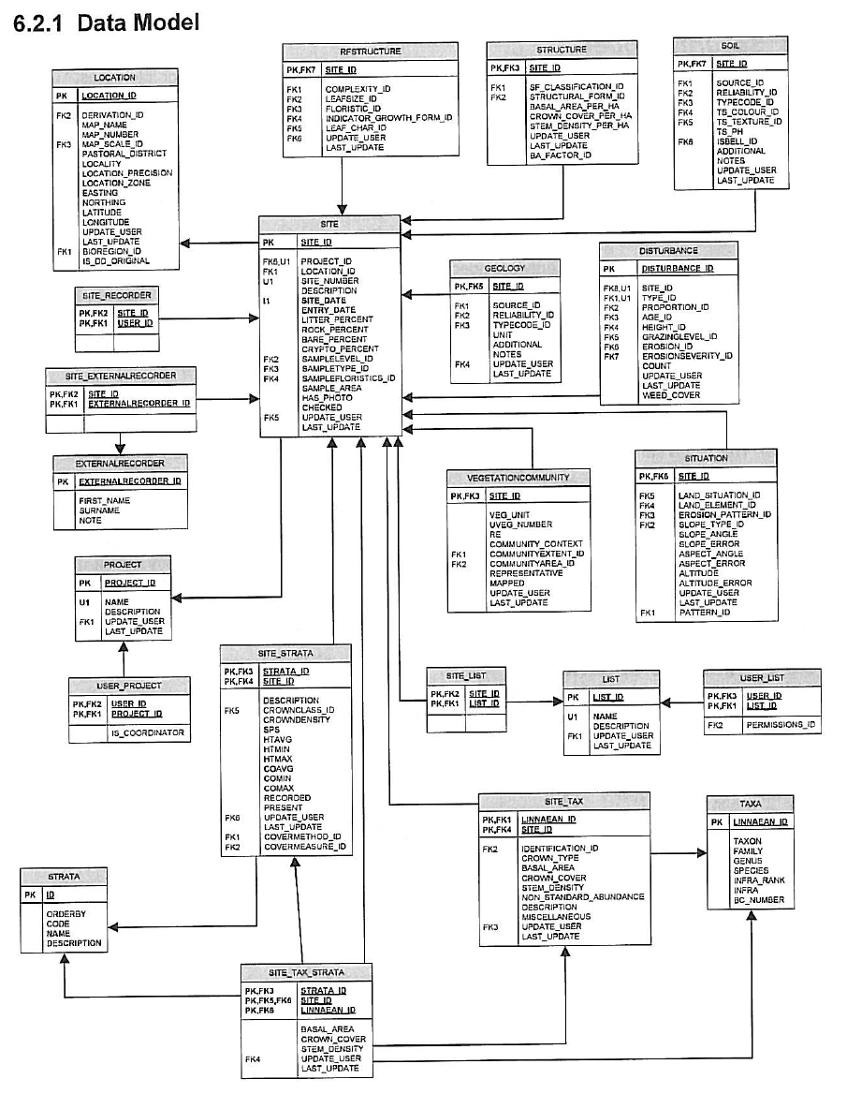
CORVEG details

Slide 6
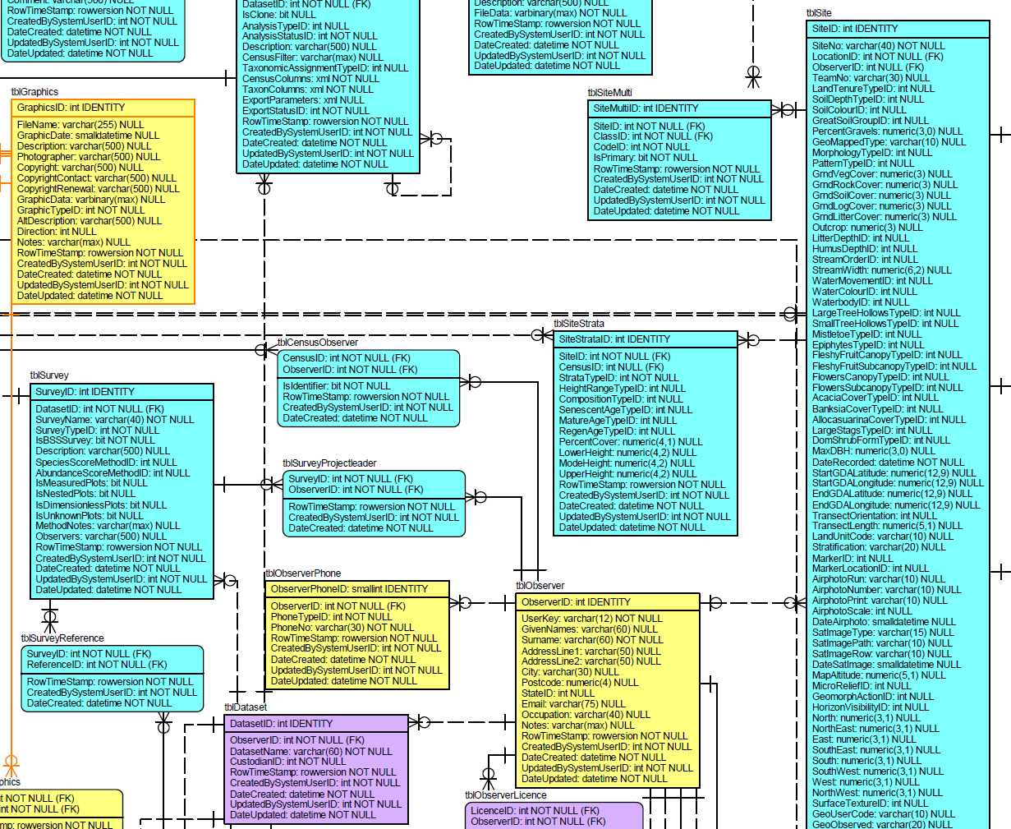
NSW (OEH Bionet Atlas)

Slide 7
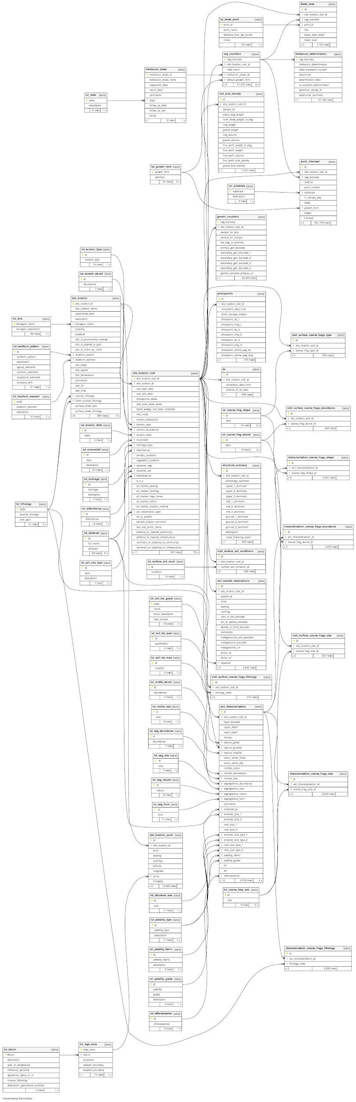
TERN AusPlots

Slide 8
How do we harmonize these?

Slide 9

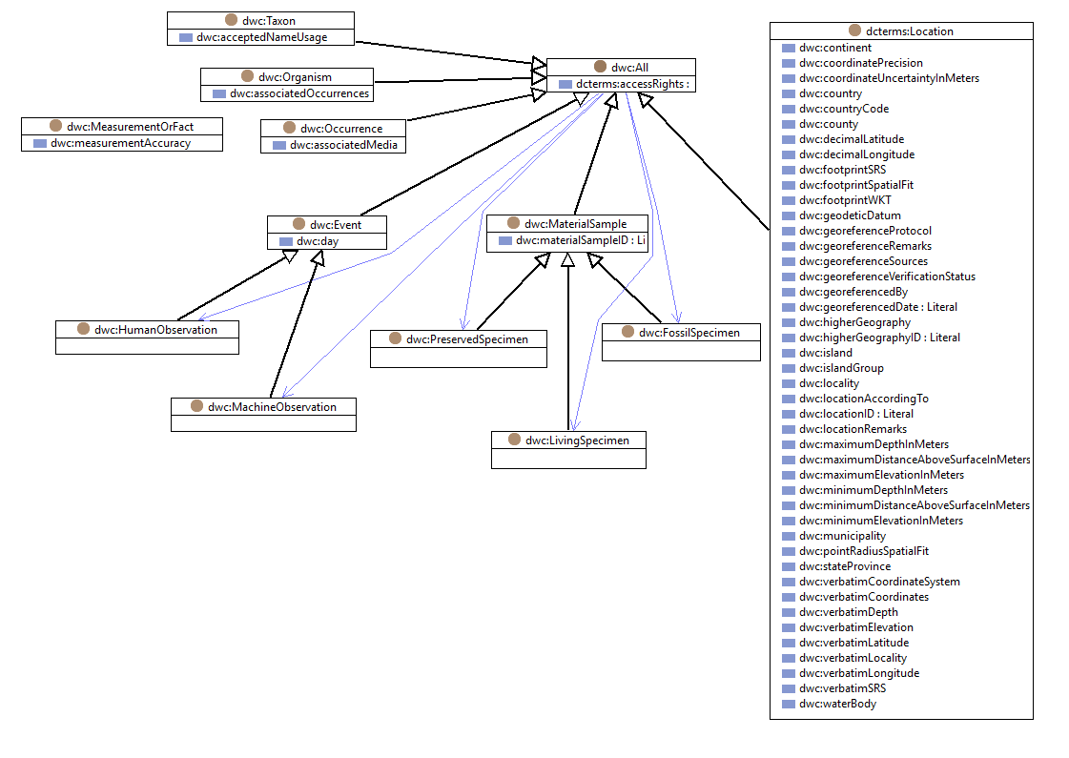
Darwin Core - biodiversity

Slide 10

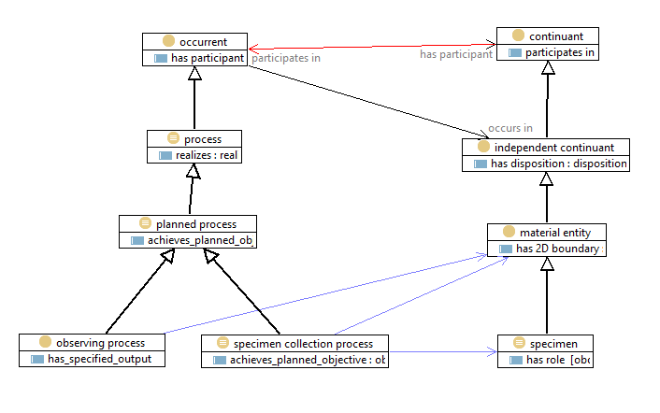
OBO - Open Biological and Biomedical Ontologies
OBI/BCO

Slide 11

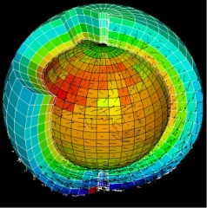

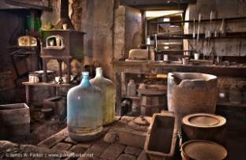
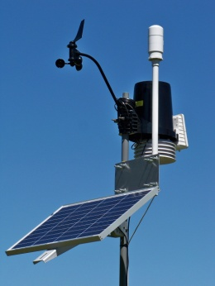
Common model for observations?
Remote sensing
Sensor
Value
Parameter
Scene
Cross-disciplinary terminology
An Observation is an action whose result is an estimate of the value of some property of the feature-of-interest that applied at the stated phenomenon-time, obtained using a specified procedure, completed at the recorded result-time
Earth science
Algorithm, code, simulator
Model, field
Variable
Volume, grid
Observations & Measurements
procedure
result
observed property
feature of interest
Metrology
Instrument
Value
Measurand
Sample
Chemistry
Instrument, analytical process
Analysis
Analyte
Sample
Environmental monitoring
Gauge, sensor
Value, time-series
Parameter
Station

Slide 12

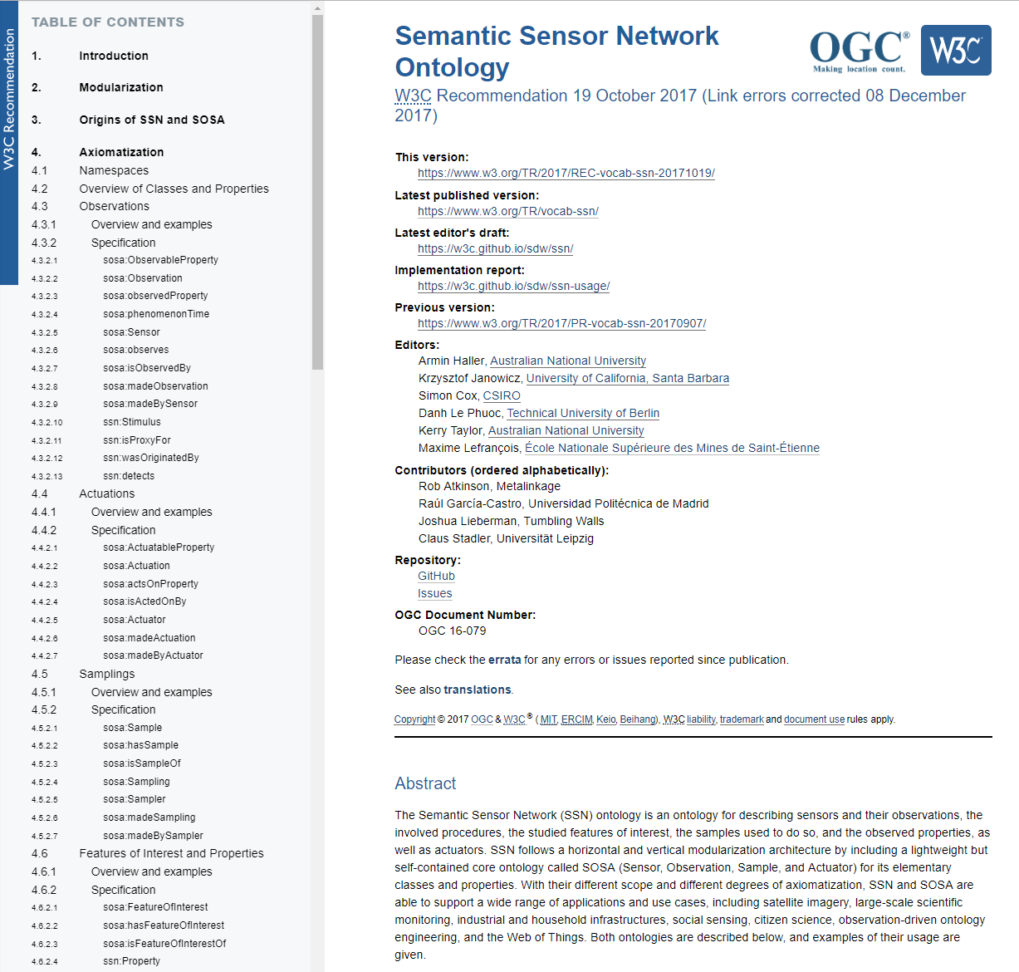
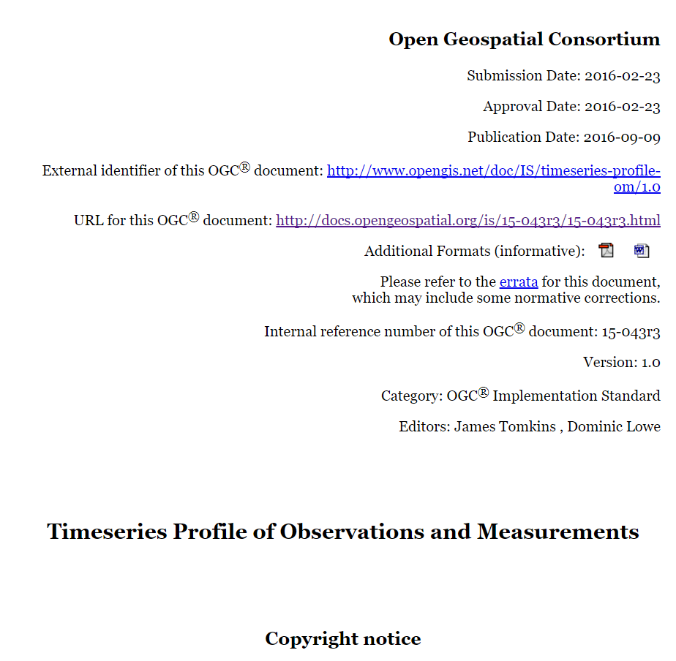

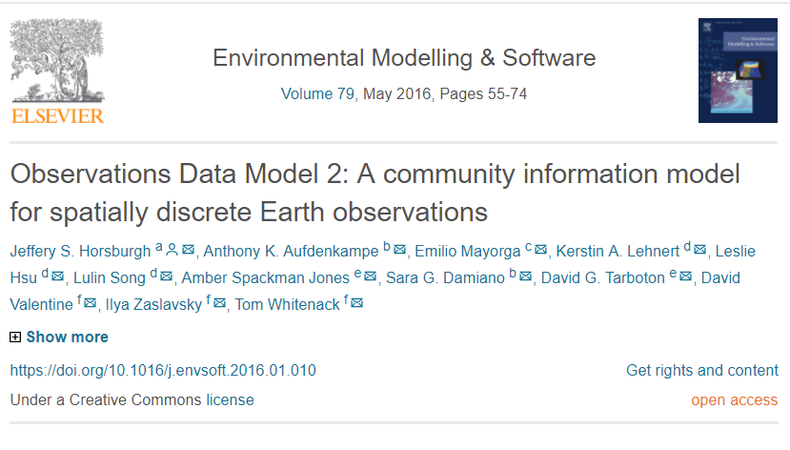
Implementations

Slide 13

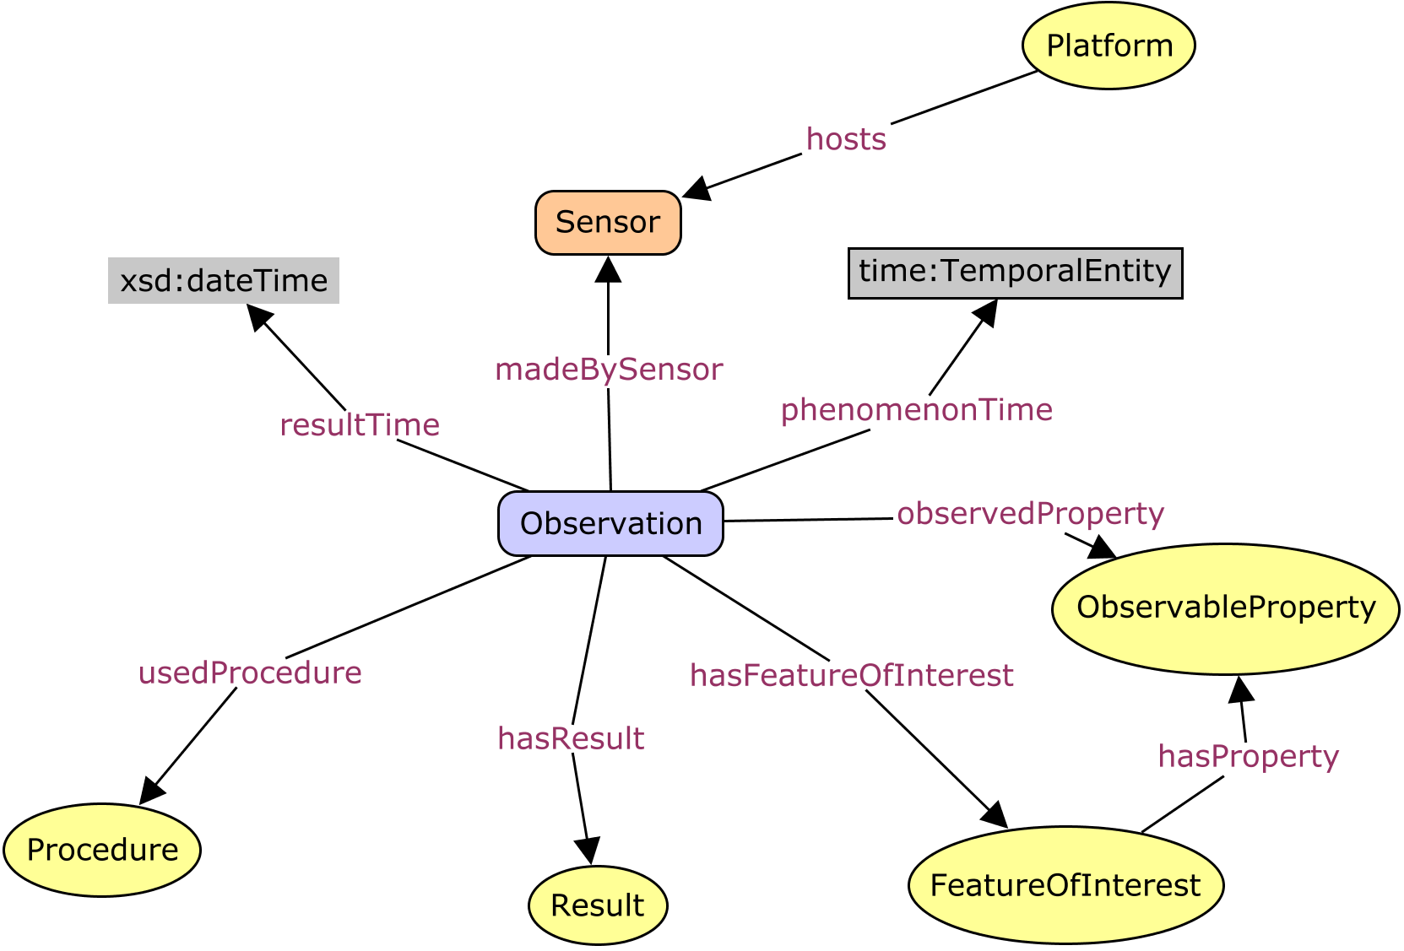


O&M / SSN
instruments and sensors
observable properties
protocols and procedures
object types (features)

Slide 14
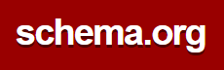
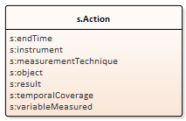
SSN
Observation
resultTime
madeBySensor
usedProcedure
hasFeatureOfInterest
hasResult
phenomenonTime
observedProperty

Slide 15
O&M / SSN
observable properties
the application-domain
object types (features)

Slide 16
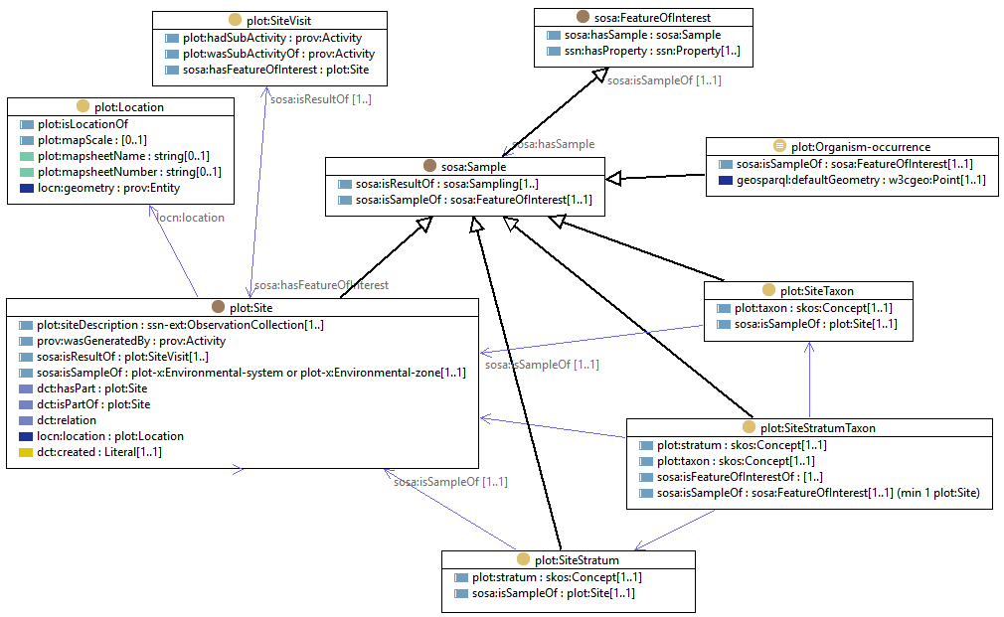
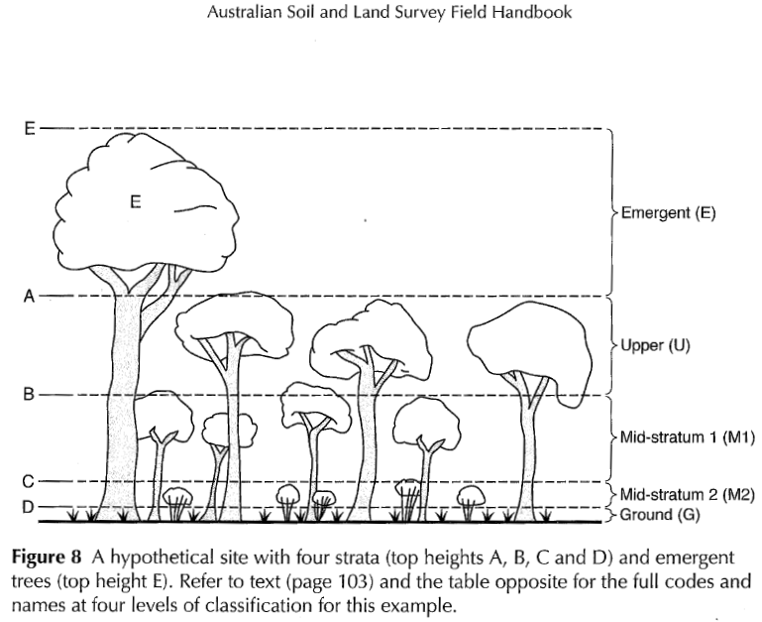
TERN-Plot domain model

Slide 17
CORVEG details
Observations are organized in thematic groups

Slide 18

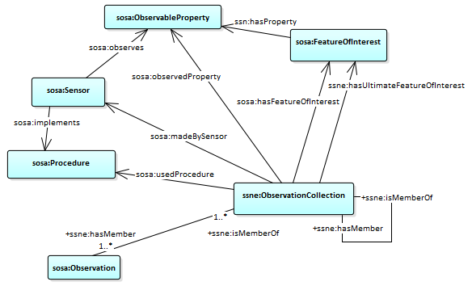
SSN extension - Observation collection

Slide 19
In practice
corveg-site:site-29099 a plot:Site ;
rdfs:label "Site 29099" ;
plot:floristics <http://linked.data.gov.au/def/corveg-cv/site-sample-floristics/c> ; # “Woody Species And Perennial Herbs”
plot:sampleLevel <http://linked.data.gov.au/def/corveg-cv/site-sample-level/q> ; # “Quaternary Site”
plot:sampleType <http://linked.data.gov.au/def/corveg-cv/site-sample-type/a> ; # “square”
plot:siteDescription corveg-site:d-29099-1 ;
dct:identifier "29099"^^corveg-def:site-id,
"618_455029"^^corveg-def:site-number ;
dct:modified "2015-10-20T08:44:07"^^xsd:dateTime ;
locn:Location corveg-location:l-28966 ;
prov:wasGeneratedBy corveg-site:p-287 ;
ssn-ext:hasUltimateFeatureOfInterest <http://linked.data.gov.au/def/corveg-cv/miscellaneous/87> .
corveg-site:d-29099-1 a ssn-ext:ObservationCollection ;
rdfs:label "Site 29099 observation collection." ;
dct:type <http://linked.data.gov.au/def/corveg-cv/ogroup/4> ; # “sampling-site (description)”
sosa:hasFeatureOfInterest corveg-site:site-29099 ;
sosa:phenomenonTime corveg-site:t1995-10-13-h0-m0-s0 ;
sosa:resultTime "2015-10-20T00:00:00"^^xsd:dateTime ;
ssn-ext:hasMember corveg-site:d-29099-1-1 .
corveg-site:d-29099-1-1 a sosa:Observation ;
rdfs:label "Site 29099 area measurement observation" ;
sosa:hasFeatureOfInterest corveg-site:site-29099 ;
sosa:hasResult [ a data:QuantitativeMeasure ;
data:standard unit:M2 ;
rdf:value 400 ] ;
sosa:observedProperty <http://linked.data.gov.au/def/corveg-cv/op/1> ; # “area”
sosa:phenomenonTime corveg-site:t1995-10-13-h0-m0-s0 ;
sosa:resultTime "2015-10-20T00:00:00"^^xsd:dateTime ;
sosa:usedProcedure <http://linked.data.gov.au/def/corveg-cv/common-method/s> . # “Site Layout Method”
corveg-site:t1995-10-13-h0-m0-s0 a time:Instant ;
time:inXSDDateTime "1995-10-13T00:00:00"^^xsd:dateTime .
URIs for terms
Standard resource types
Links between related resources
Small datatype vocabulary
https://bitbucket.org/terndatateam/ternplotdata-ontology/src/master/corveg/corveg-site.md

Slide 20
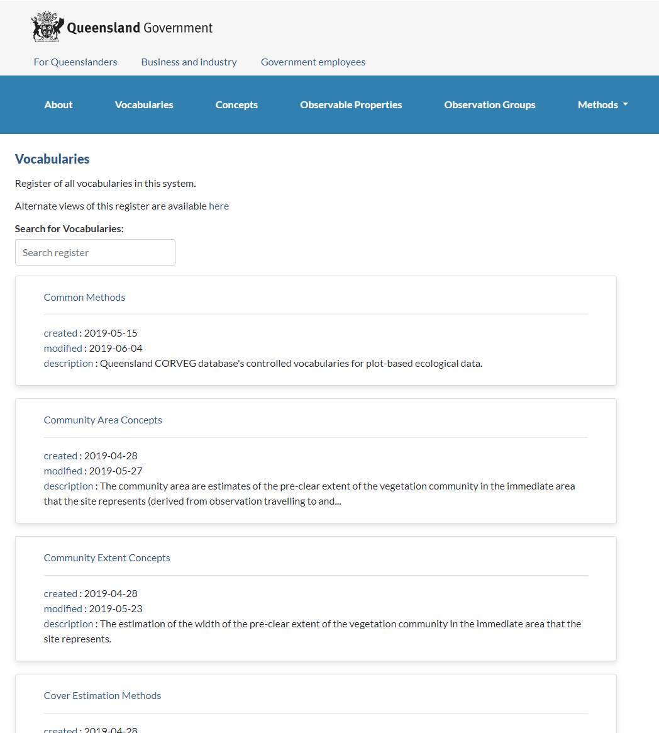
Controlled vocabularies

Slide 21
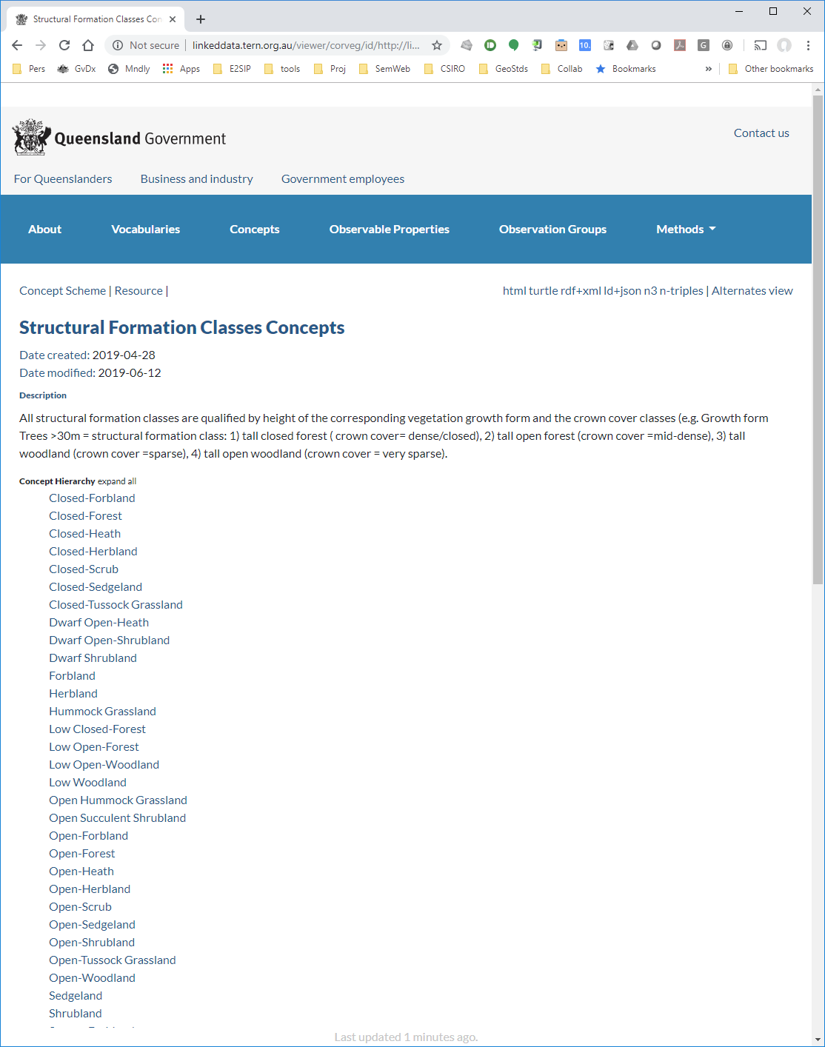
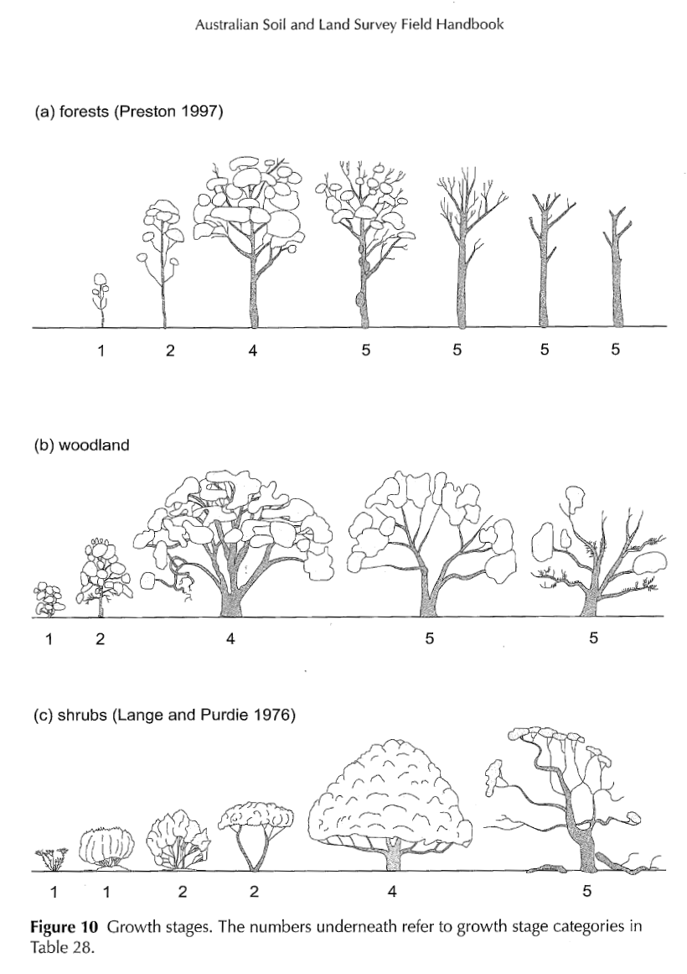
From printed page to web

Slide 22
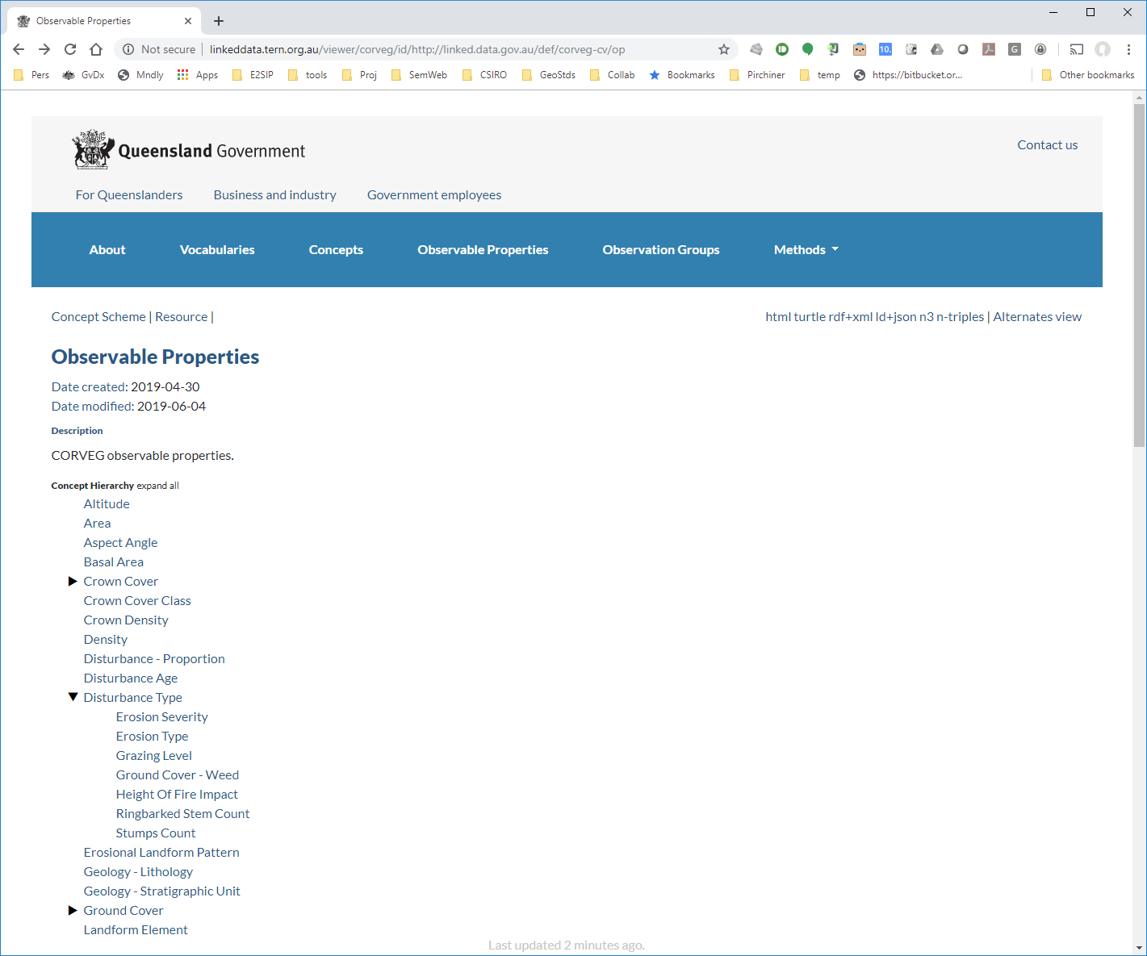
Key semantics

Slide 23
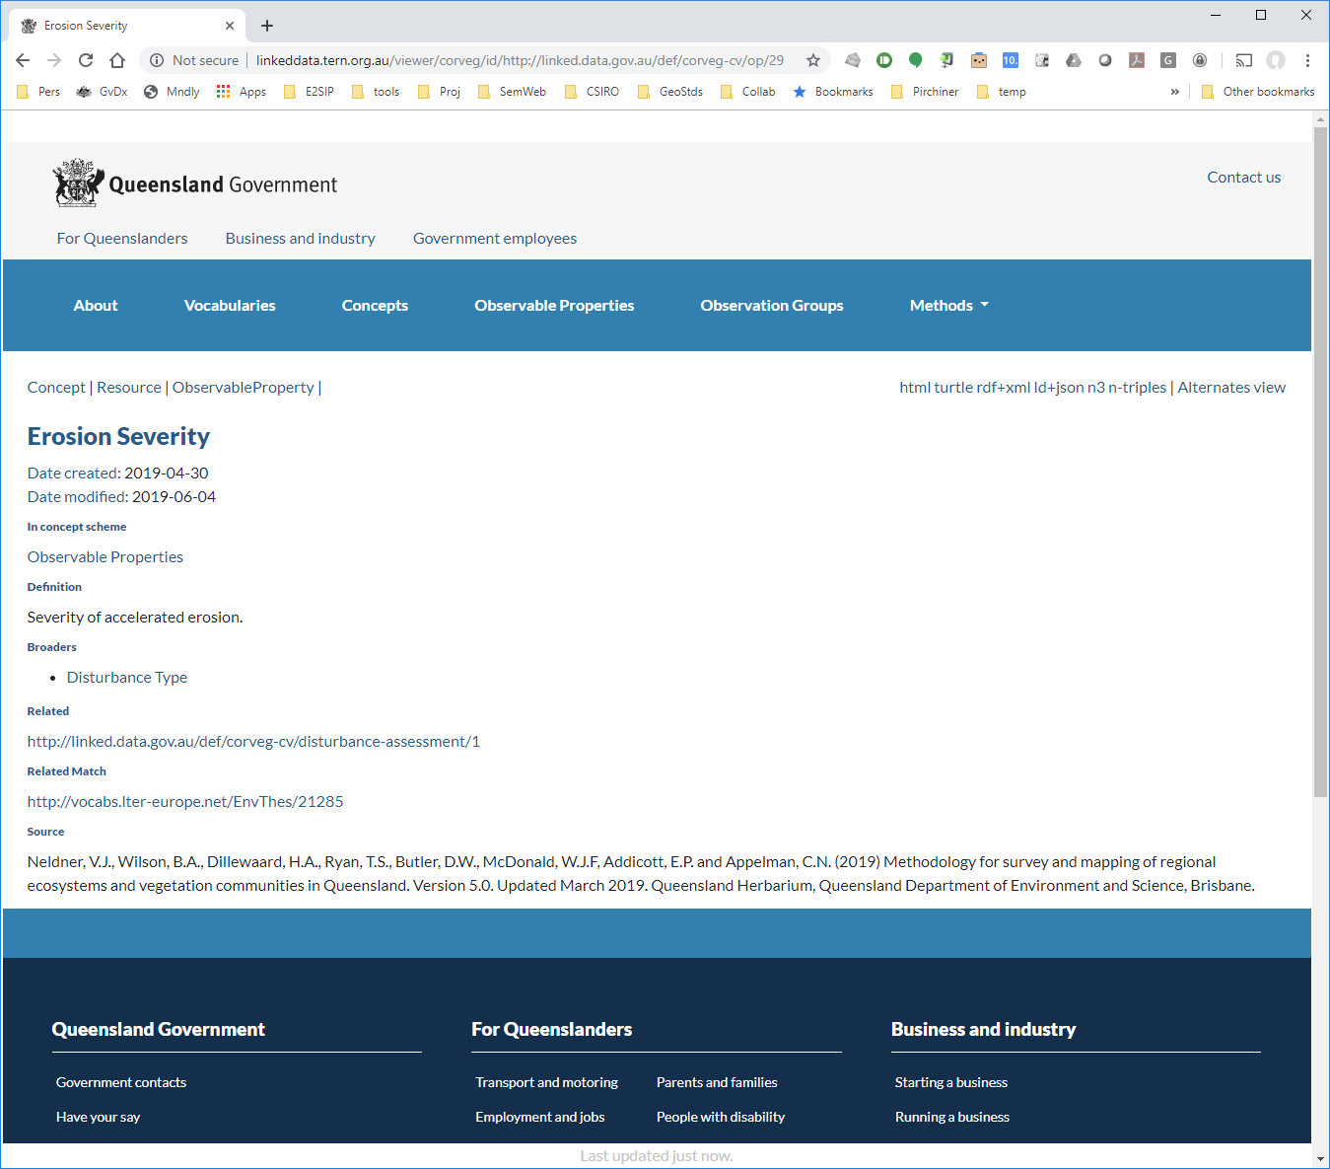
An individual concept
Denoted by a URI

Slide 24
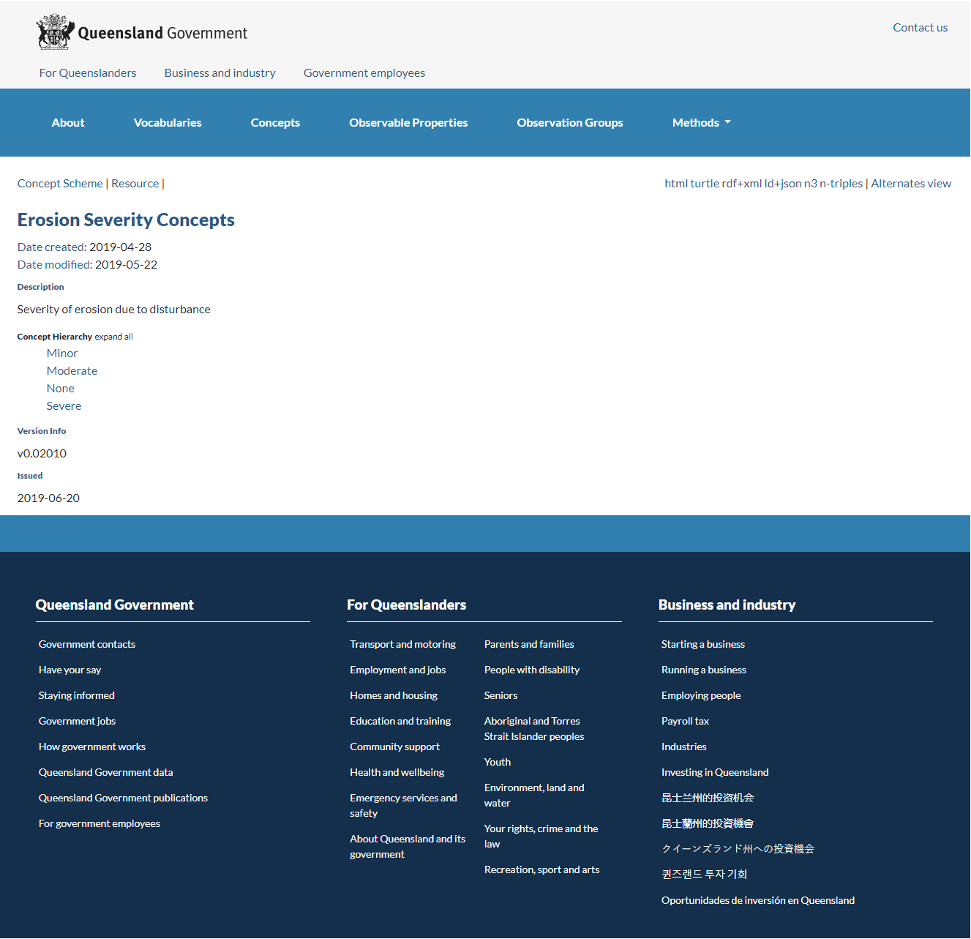
Value space for this property

Slide 25
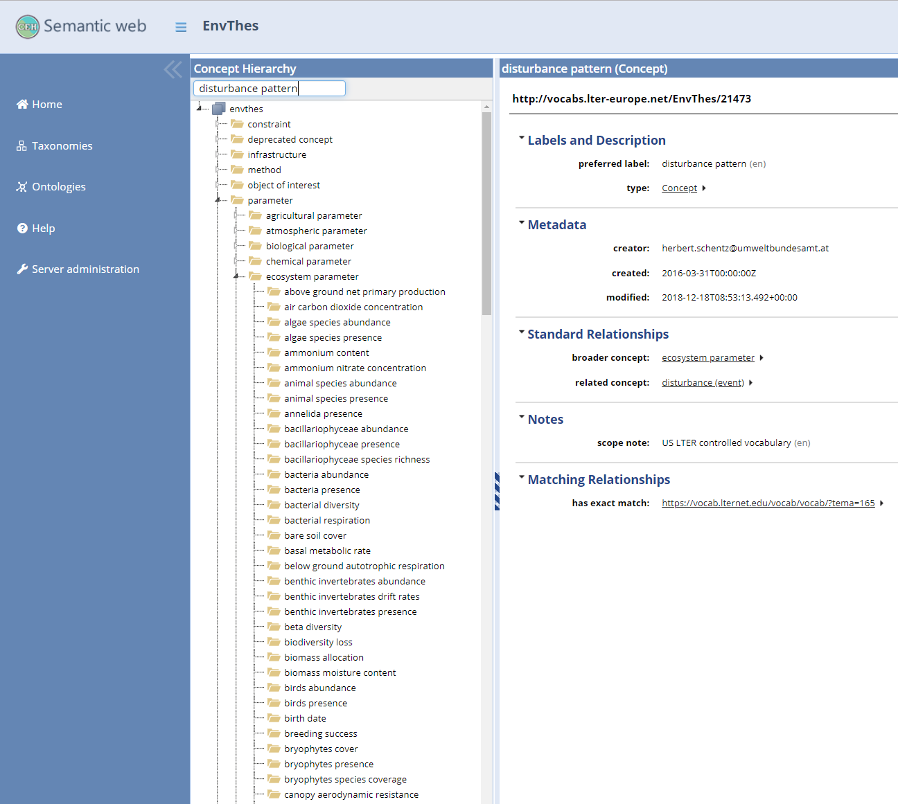
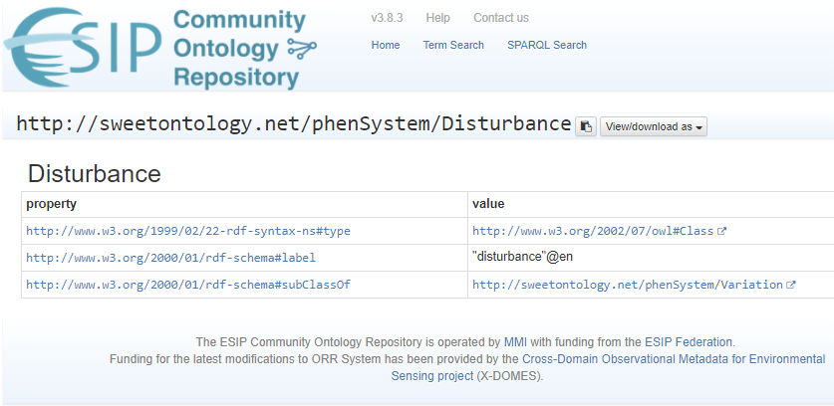
Many other potential sources

Slide 26
What have we learned?
SSN + SSN-ext almost enough ...
… if supplemented by
small domain model (TERN-Plot)
lots of controlled vocabularies
Separate maintenance of
data structure (ontology)
semantics (vocabularies)
RDF Triples are a scalable/flexible data storage option
Newbies find the abstract model hard to grok … at first
Many pieces ⇒ a lot of choreography
Data structures are stable, but alignment of controlled vocabularies is needed
Additional potential alignments will support additional potential entailments

Slide 27
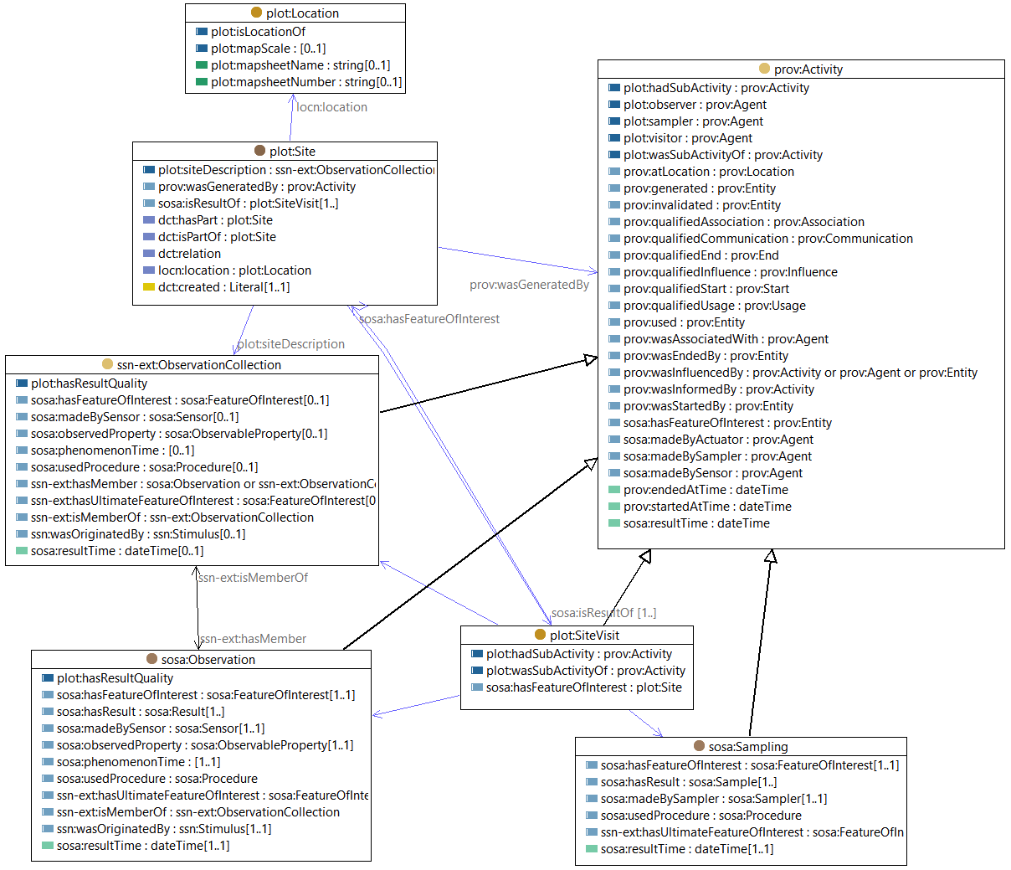
Example: PROV-O

Slide 28
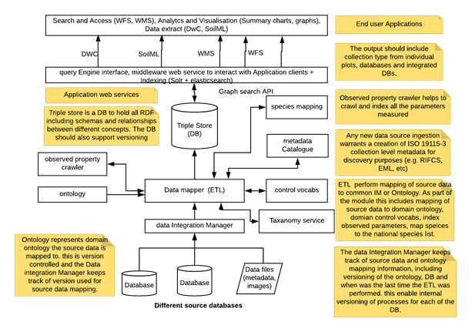
TERN-Plot architecture

Slide 29
Acknowledgements
TERN:
David Turner
Tom Saleeba
Mosheh Eliyahu
Edmond Chuc
Tina Schroeder
Queensland Government:
Jason Shen

